Slide 1
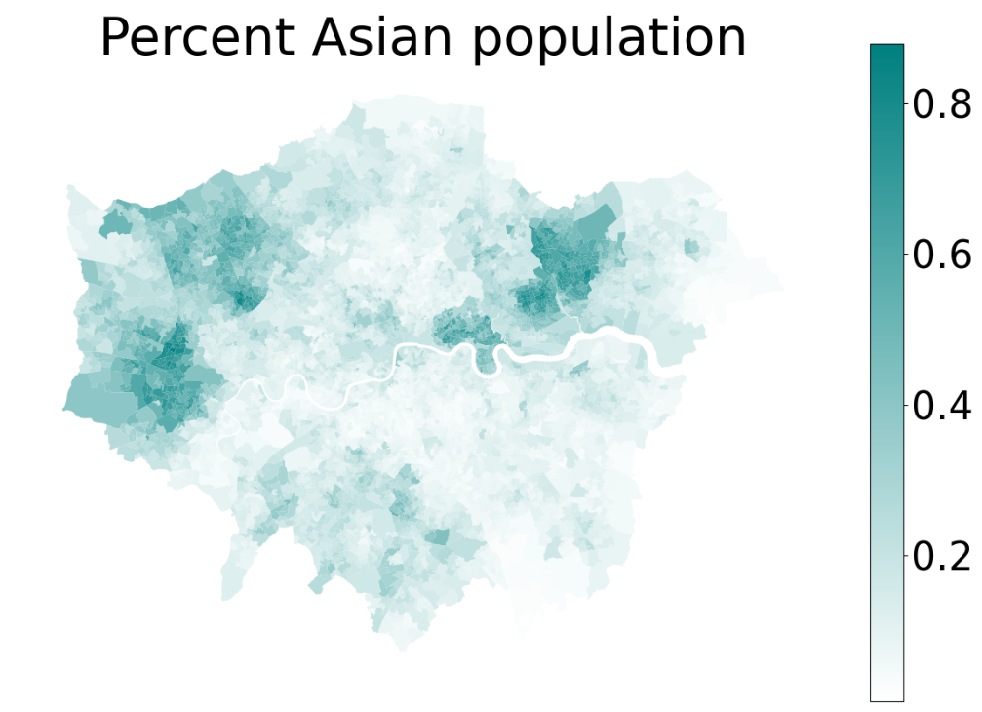
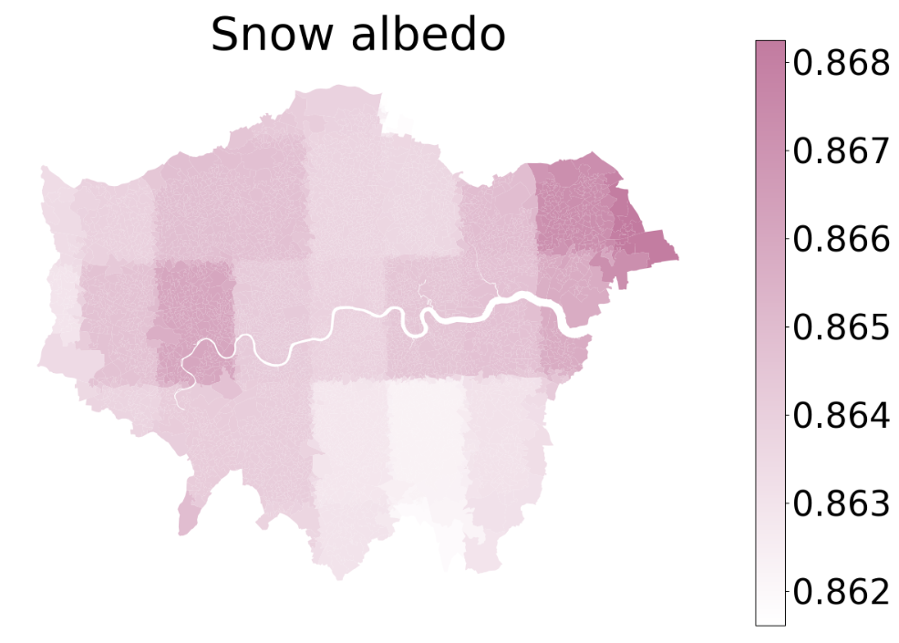
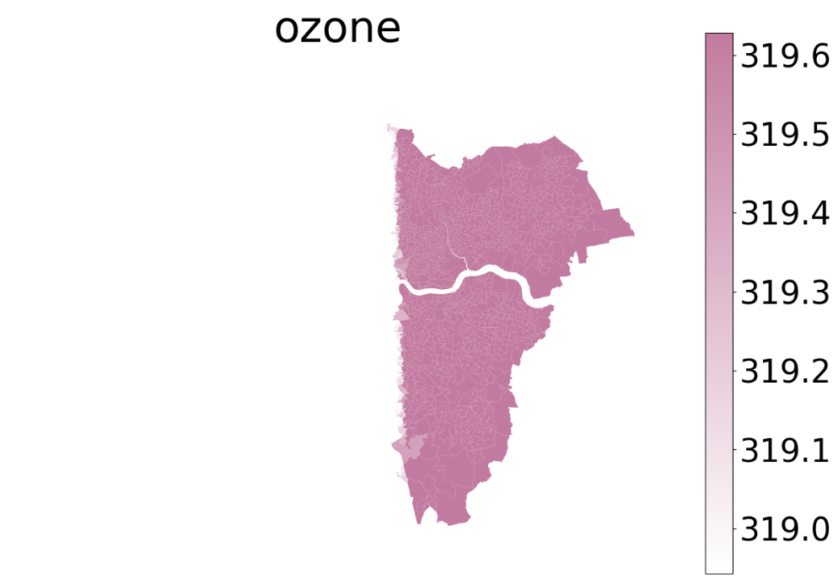
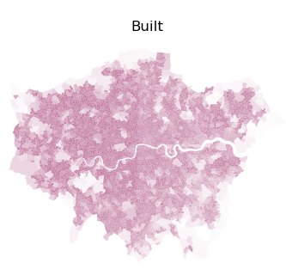
Summary of the first six weeks
Part A. GNN & Prescription Outcomes
Feature Engineering
Preprocessing - Missing values ​​and standardization
Type. A
Type. B
Type. C
Type. D
The variables in the dataset can be roughly divided into four categories:
Type A: socioeconomic variables - no missing values ​​except 'income’,
missing 'incomes’ ​​are filled with the mean of adjacent nodes
Type B: Coarse-resolution environment variables - Currently not in use
Type C: Missing environment variables- Only ‘ozone’ and ‘PM2.5’ variables, discarded
Type D: Environment variables with spatial statistics - Use directly

Slide 2
Part A. GNN & Prescription Outcomes
Feature Engineering
Variable selection
Variable sets selected based on correlation matrix and optimal VIF iterations and expert knowledge
The blue age variable group varies according to the prescription disease
The red ones are common control variables for disease study
NO Variable VIF
0 c_percent Aged 10 to 14 years 45.952547
1 c_percent Aged 15 to 19 years 17.553844
2 c_percent Aged 20 to 24 years 34.235183
3 c_percent Aged 25 to 29 years 36.637117
4 c_percent Aged 30 to 34 years 57.487355
5 c_percent Aged 35 to 39 years 72.134061
6 c_percent Aged 40 to 44 years 72.721801
7 c_percent Aged 65 to 69 years 34.952682
8 c_percent Aged 70 to 74 years 33.932029
9 c_percent Aged 75 to 79 years 26.678872
10 c_percent Aged 80 to 84 years 19.878863
11 c_percent Aged 85 years and over 10.233184
12 c_percent mixed 21.422281
**13 c_percent white 265.631569
14 c_percent 2. Professional occupations 51.946483
15 c_pop_density 6.512659
16 e_ndvi 77.371630
17 e_water 5.922018
18 e_trees 5.771038
19 e_grass 5.454700
20 e_bare 25.037494
21 c_percent Asian 47.202022
22 c_percent black 27.501667
23 c_percent buddhist 3.231169
24 c_percent muslim 11.905714
25 c_percent no central heating 8.221471
26 c_percent communal heating 1.964879
27 c_percent TFW less than 2km 33.180717
28 c_percent 49 or more hours worked 25.839132
29 c_percent commute on foot 31.012111
30 c_percent commute metro rail 10.096440
31 c_percent commute bus 18.608891
32 c_percent commute bicycle 6.593285
33 c_percent student moved to address 5.573166
34 c_percent occupancy rating bedrooms -2 8.074982
35 c_percent occupancy rating bedrooms -1 28.572854
36 c_percent 10 years or more 64.176979
37 c_percent 2 years or more but less than 5 years 20.514091
38 c_percent 5 years or more but less than 10 years 29.012475
39 c_percent married or … same sex 3.094610
40 c_percent married or … civil partnership 2.892293
41 c_percent separated but still legally married … 1.191737
42 c_percent divorced or … now legally dissolved 1.587789
43 c_percent cannot speak english well 22.866308
44 c_percent cannot speak english 7.048612
45 c_percent households deprived in four dimensions 2.527207

Slide 3
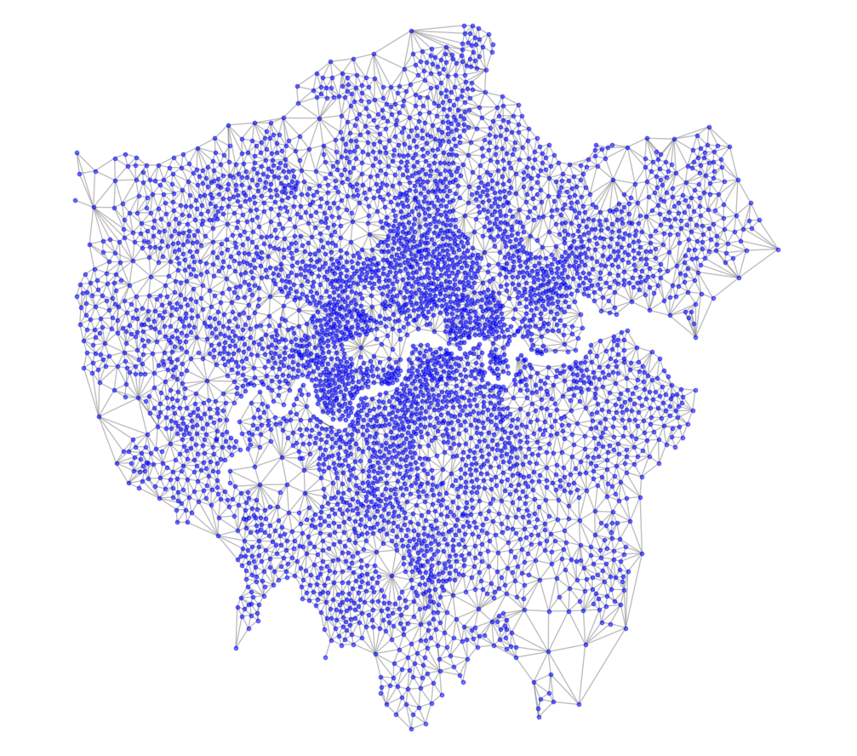
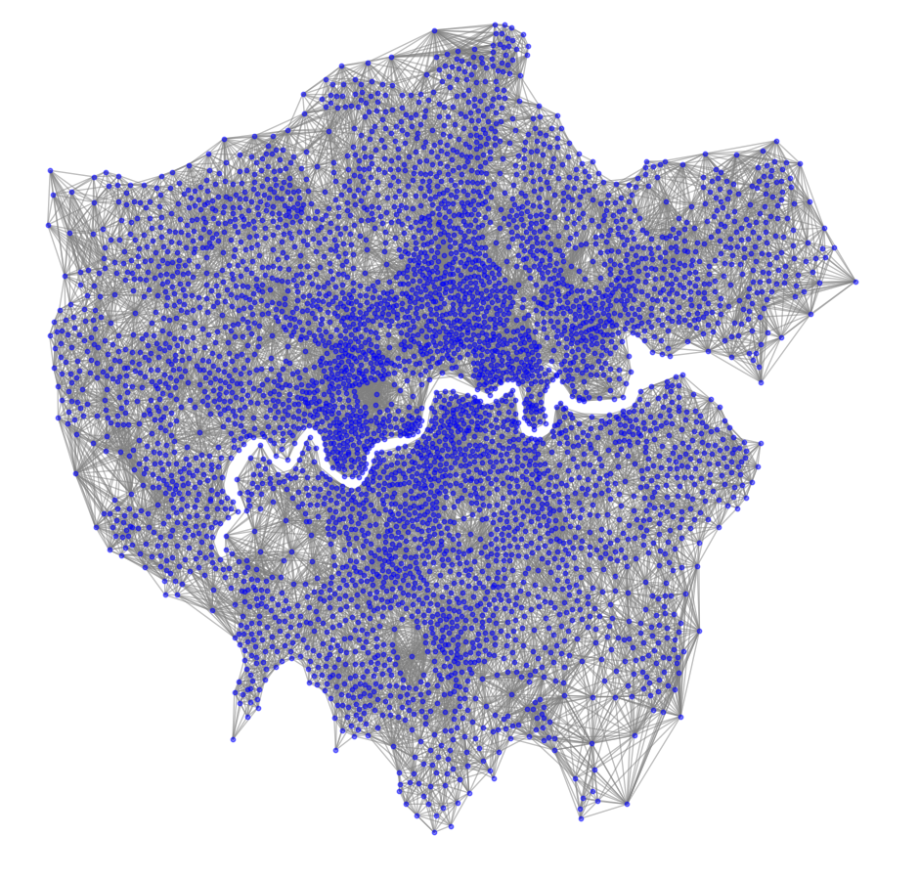
Part A. GNN & Prescription Outcomes
Spatial features - Networks for GNN models
Type A : Find all neighbors
Type B : Find Two-level neighbors, weighted by distance
With GIN model test (No optimization strategy used) | RMSE | MAE | R2 | Update: After further confirmation of the variables. Type A network now performs better.
Type A Network | 7.4834 | 5.6655 | 0.6604 | How to choose a suitable network requires further discussion?
Type B Network | 8.3367 | 6.2843 | 0.5786

Slide 4
Part A. GNN & Prescription Outcomes
Models comparation
Using anxiety and depression as the target variables and given same independent variables.
Using the TypeA network.
Using random search strategy.
The red ones are baseline models
The GNN models do not use any optimization strategy, so the current results are not optimal.
Depression | GAT | GCN | GIN | GraphSAGE | SEM | SLM | LightGBM
RMSE | 4.7247 | 5.6201 | 4.2235 | 4.9359 | 6.3324 | 4.9753 | 5.6281
MAE | 3.5873 | 4.3774 | 3.1364 | 3.8316 | 5.1818 | 3.8111 | 4.3042
R² | 0.7322 | 0.6211 | 0.7860 | 0.7077 | 0.5189 | 0.7030 | 0.6196
Anxiety | GAT | GCN | GIN | GraphSAGE | SEM | SLM | LightGBM
RMSE | 7.2924 | 7.7104 | 6.6958 | 6.8938 | 9.3223 | 7.4341 | 8.2533
MAE | 5.6285 | 5.9071 | 5.0909 | 5.3068 | 7.6431 | 5.7181 | 6.1989
R² | 0.6775 | 0.6395 | 0.7281 | 0.7118 | 0.4730 | 0.6649 | 0.5816

Slide 5
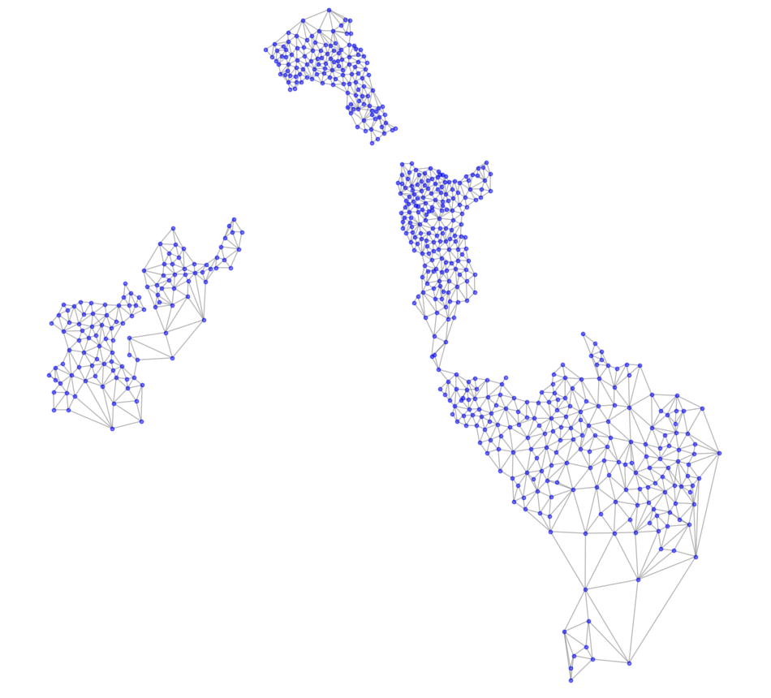
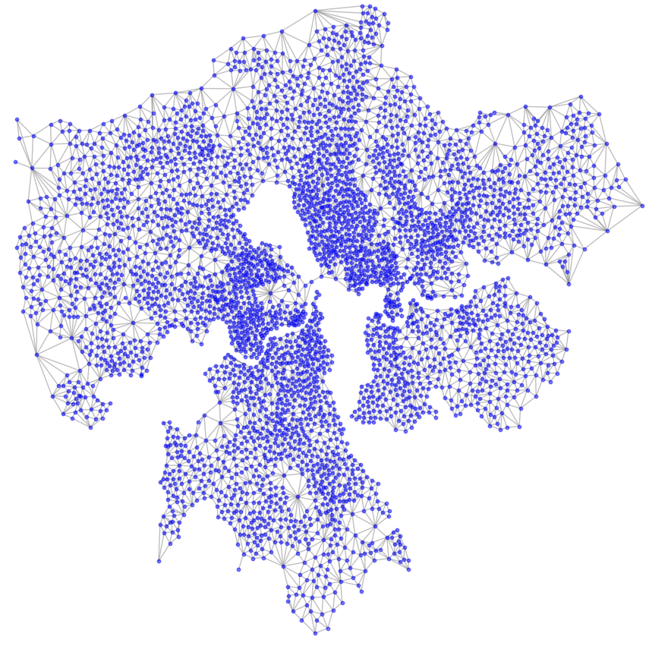
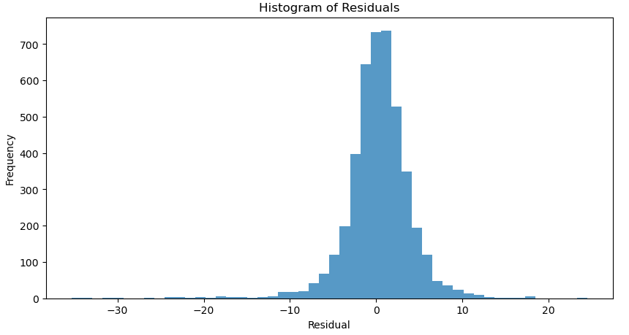
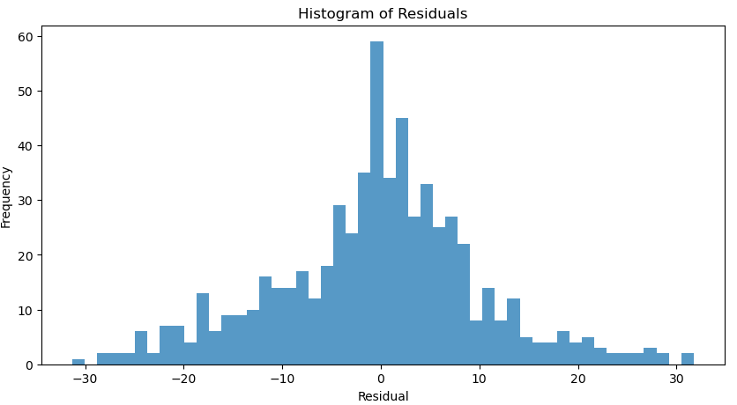
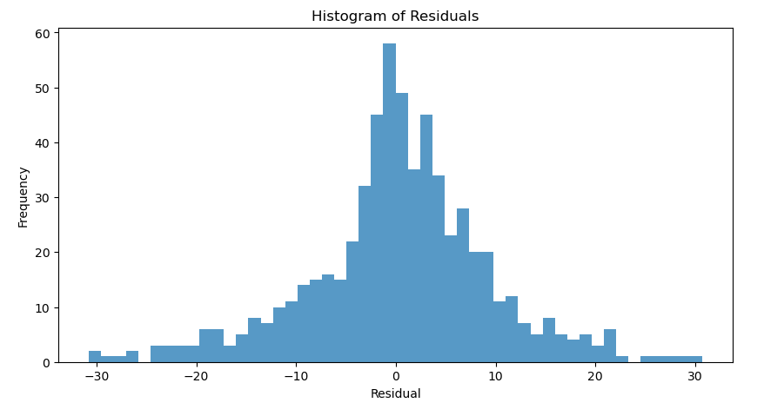
Part A. GNN & Prescription Outcomes
Generalization test A - Split Region of Interest
Pre-extract the region of interest
Train with data from other regions - Use the region of interest as a test set
Random Search – Optimized GIN | RMSE | MAE | R2
Subset of the training set | 3.8978 | 2.6260 | 0.9043
Testing set (Raw) | 10.5191 | 7.8546 | 0.4709
Testing set (Processed) | 9.1727 | 6.6760 | 0.5977
residuals for subset of training set
residuals for Testing set
Testing set (Processed)

Slide 6
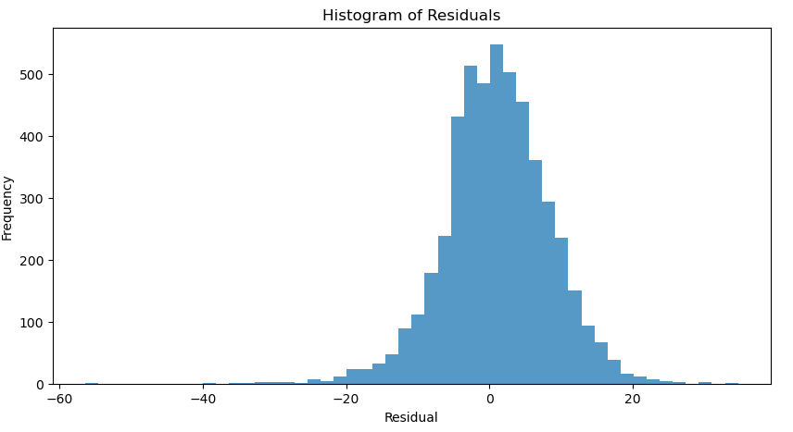
Part A. GNN & Prescription Outcomes
Generalization test B - Monte Carlo Cross Validation
When randomly splitting subgraphs, still need to consider the problem of boundary nodes.
The model requires a lot of computing power.
However, based on two experiments, we can conclude – model is generalizable in predicting prescription results
Random Search - Optimized GIN | RMSE | MAE | R2
Monte Carlo Cross Validation | 7.4398 | 5.7125 | 0.6644

Slide 7
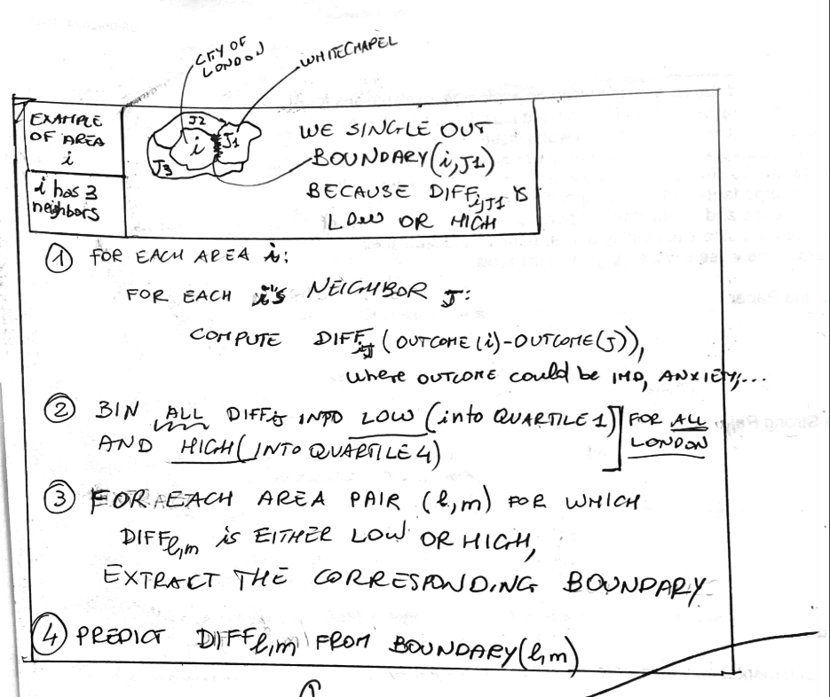
Part B. Border Vacuum
Edge Prediction
According to this theory, the edge attribute (prescription outcome difference of adjacent LSOAs) is established on the network of TypeA.
According to the definition of border vacuum. Use the node's environment features to predict the link.
The variables are as follows:
'e_ndvi', 'e_water', 'e_trees', 'e_grass', 'e_bare','e_built','e_shrub_and_scrub','e_crops','e_flooded_vegetation’

Slide 8
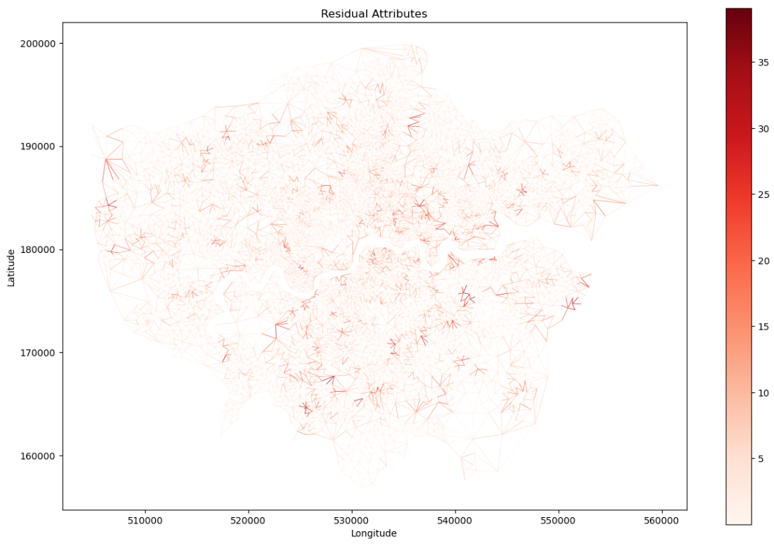
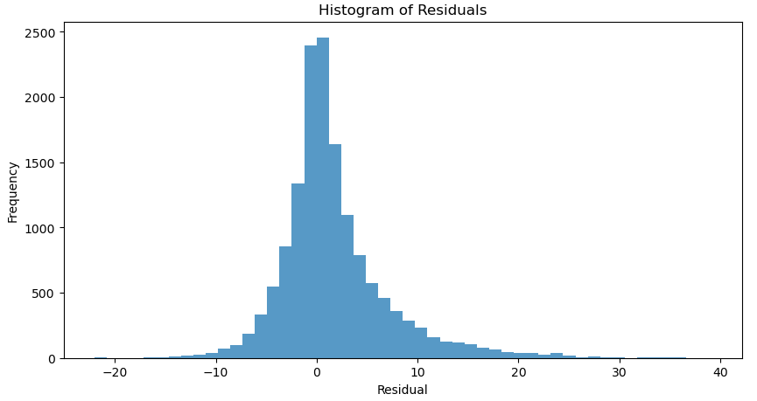
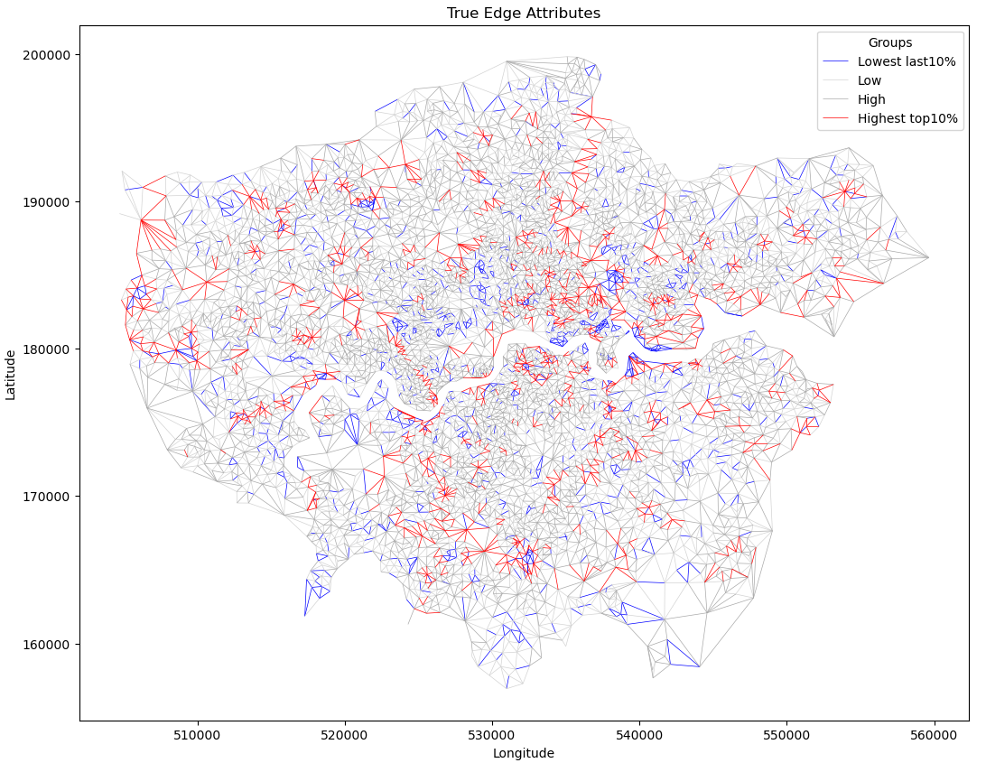
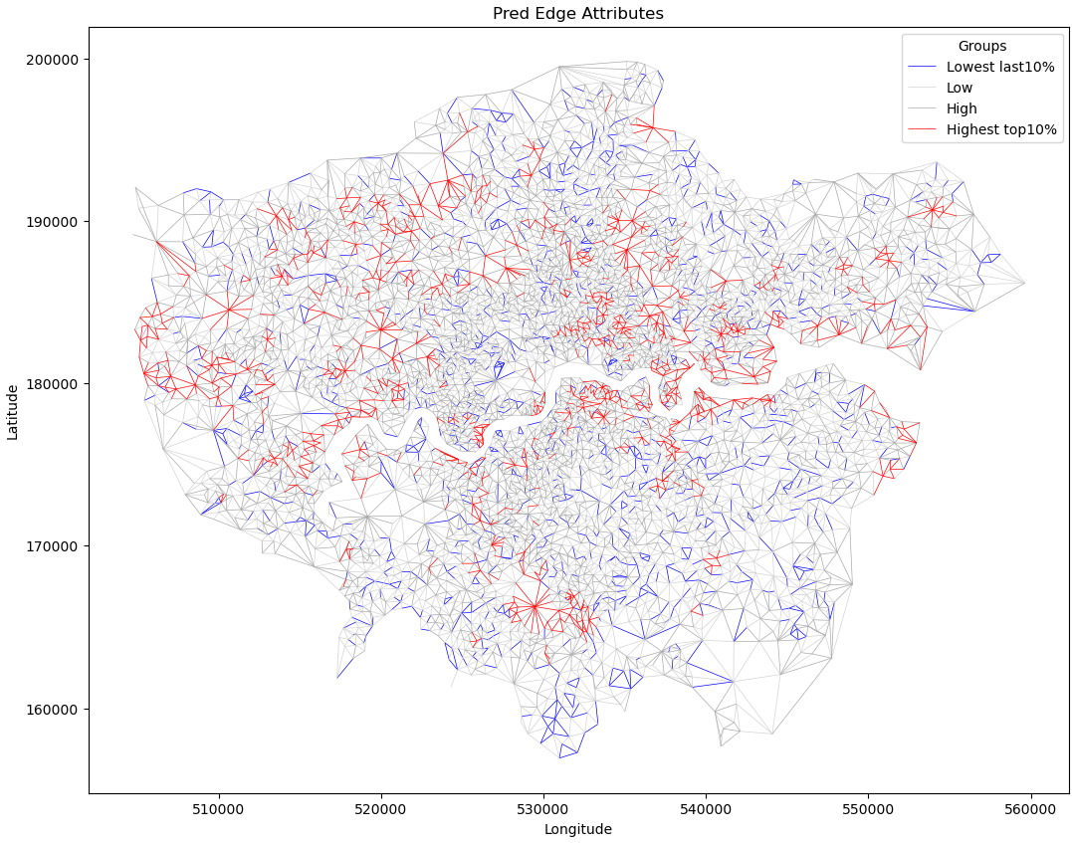
Part B. Border Vacuum
Edge Prediction
‘border vacuum’ prediction | RMSE | MAE | R2
Random Search - Optimized GIN | 5.7563 | 3.7050 | 0.3155
Prediction residual distribution
Edge attribute distribution of anxiety variable
Predicted Edge attribute distribution of anxiety variable

Slide 9
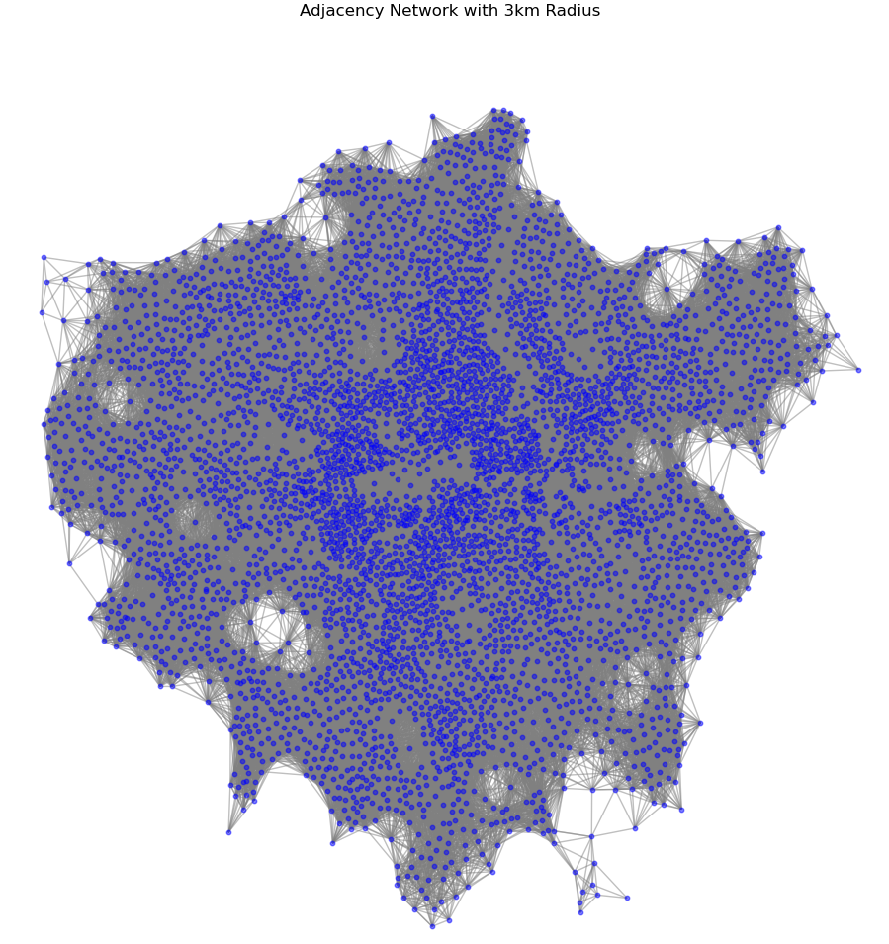
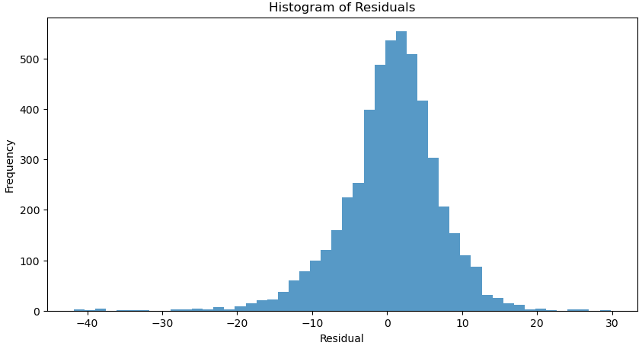
Part C. Dr.Ivica’s idea
Random Search - GATv2 | RMSE | MAE | R2
Anxiety | 6.5184 | 4.8460 | 0.7424
The results are similar to those of Type B networks.
Slightly worse than Type A network.
But because the network is very dense and the calculation is slow, I only tried 5 random searches, which is not optimal.

Slide 10
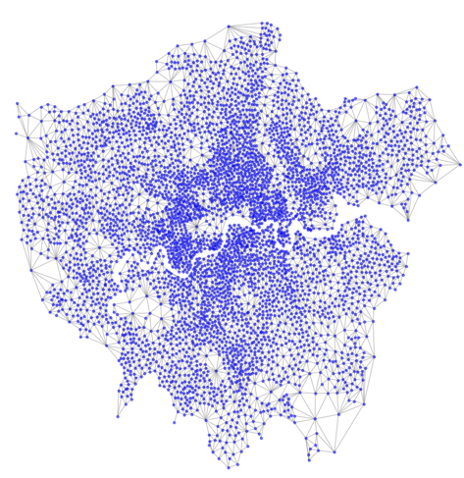
Now with this simplest network, We have the best results
In fact, it is more reasonable to only consider directly adjacent nodes and not use distance weights.
A more reasonable idea is to use accessibility or traffic between regions as weights. Or keep equal weights like now.
Depression | GAT | GCN | GIN | GraphSAGE | SEM | SLM | LightGBM | GATv2
RMSE | 4.7247 | 5.6201 | 4.2235 | 4.9359 | 6.3324 | 4.9753 | 5.6281 | 3.3566
MAE | 3.5873 | 4.3774 | 3.1364 | 3.8316 | 5.1818 | 3.8111 | 4.3042 | 2.4008
R² | 0.7322 | 0.6211 | 0.7860 | 0.7077 | 0.5189 | 0.7030 | 0.6196 | 0.8648
Anxiety | GAT | GCN | GIN | GraphSAGE | SEM | SLM | LightGBM | GATv2
RMSE | 7.2924 | 7.7104 | 6.6958 | 6.8938 | 9.3223 | 7.4341 | 8.2533 | 5.3839
MAE | 5.6285 | 5.9071 | 5.0909 | 5.3068 | 7.6431 | 5.7181 | 6.1989 | 3.9211
R² | 0.6775 | 0.6395 | 0.7281 | 0.7118 | 0.4730 | 0.6649 | 0.5816 | 0.8242

Slide 11
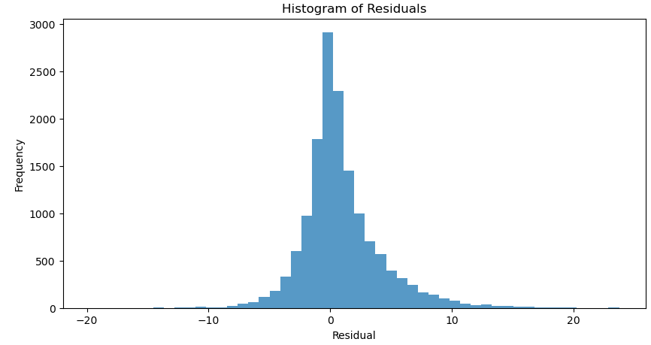
Outlook
A single-layer network with GATv2 can be A good result for Prescription outcome prediction task.
Further explore how to build a network? For example, reachability, flow, etc. as weights.
The geocoding mentioned by Stephen has been put into the model and slightly improved the link prediction.
Model explanation: GNNexplainer or SHAP, I have tried some things, but not yet implemented.
For the GATv2 model, it may be necessary to explain the attention mechanism as well.
When testing generalization with split regions, the buffer node set is still not established correctly now.
Link prediction for border vacuum - The indicators are not very good. But the residual histogram looks fine?
It still looks reasonable to explain the prescription diff caused by border vacuum through environmental variables
But currently only a few high-resolution environment variables are used.
Resolution of most environmental variables in MEDSAT is too coarse.
Perhaps other remote sensing dataset could be brought in?
‘border vacuum’ prediction | RMSE | MAE | R2
Anxiety | 5.7563 | 3.7050 | 0.3155
Depression | 3.3923 | 2.2617 | 0.4646

